Slide 1
Flacco – Expensive Features
Data Analytics 1 – Case Study Group 03

Slide 2
Agenda
Introduction
Exploratory Landscape Analysis, Cell Mapping Techniques
Flacco Dataset
Data Preprocessing
Visualization
Normality (Tests, Transformation)
Outlier Detection
Unsupervised Learning
Principal Component Analysis
Multi-Dimensional Scaling
Clustering

Slide 3
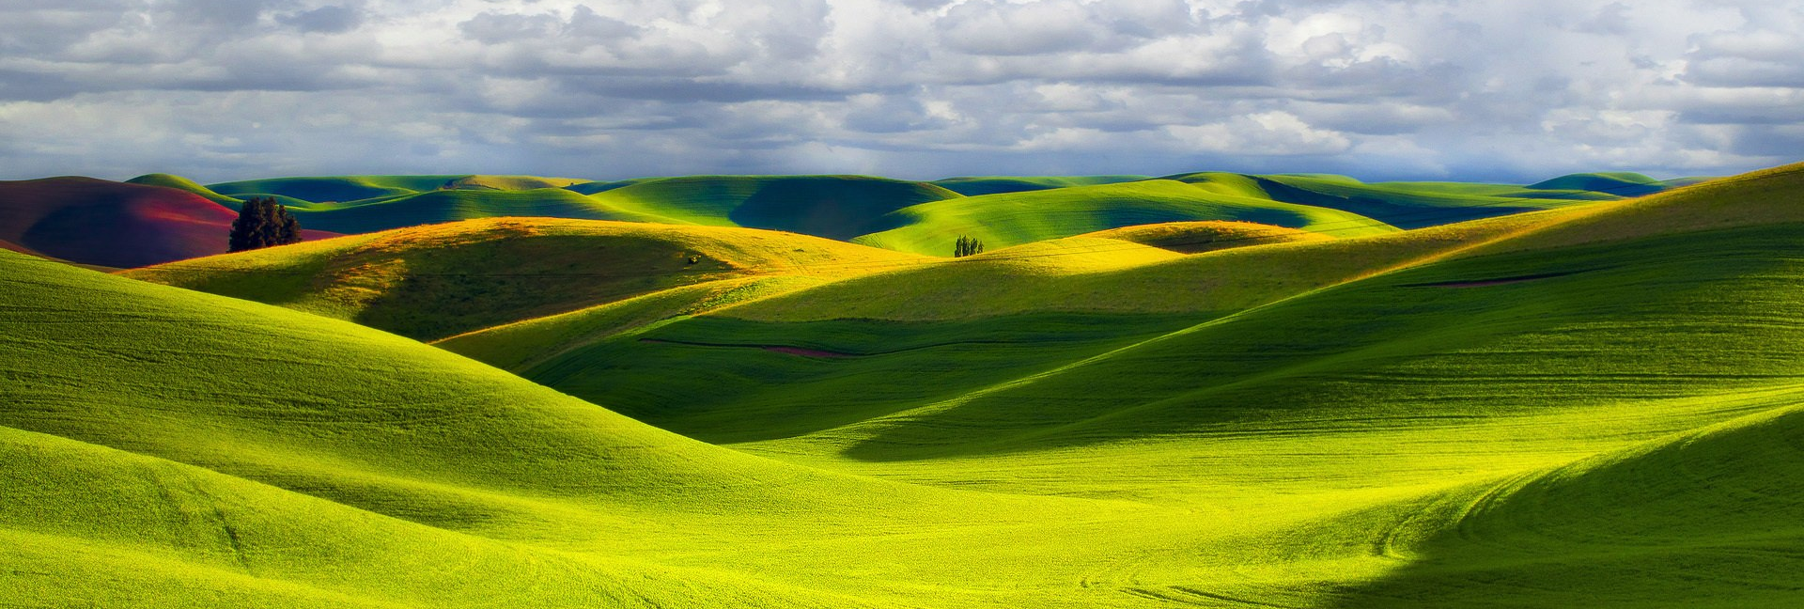
Exploratory Landscape Analysis
Image: http://eskipaper.com/images/open-landscape-wallpaper-1.jpg

Slide 4
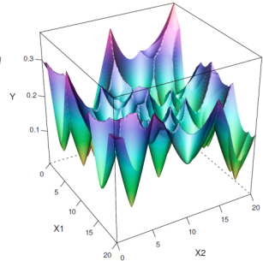
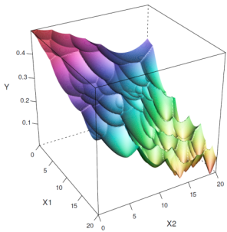


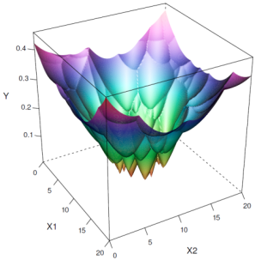

Exploraty Landscape Analysis (ELA)
analysis of Black-box Optimization Problems
Different problem instances …
… require different opt. algorithms
“ELA aims at characterizing the problem landscape and deriving rules for determining how problem properties influence algorithm performance”
Kerschke, P., Preuss, M., Wessing, S., Trautmann, H., Detecting Funnel Structures by Means of Exploratory Landscape Analysis 2015.
Notes:
Introduce basic idea of ELA

Slide 5
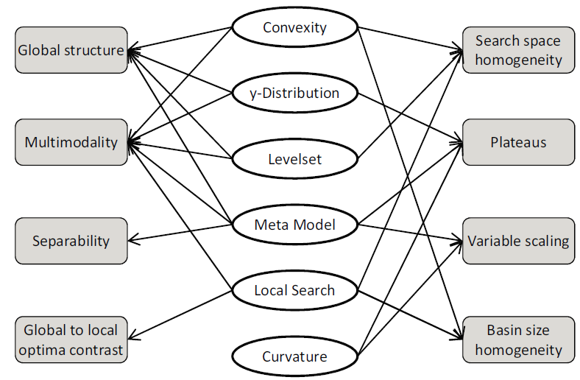

Exploraty Landscape Analysis (ELA)
ELA-Featureset
Unknown problem landscape …
… are overcome by ELA features
High dimensionality
Large landscape
Computational effort
Image: http://medcitynews.com/wp-content/uploads/Black-Box-Art.png
Mersmann, O., Bischl, B., Trautmann, H., Preuss, M., Weihs, C., Rudolph, G., Exploratory Landscape Analysis in Proceedings of GECCO 2011, pp. 829-836.
Notes:
How to overcome the unknown problem landscape? Introduction of high / low level ELA features.
High-level features in rectangles.

Slide 6
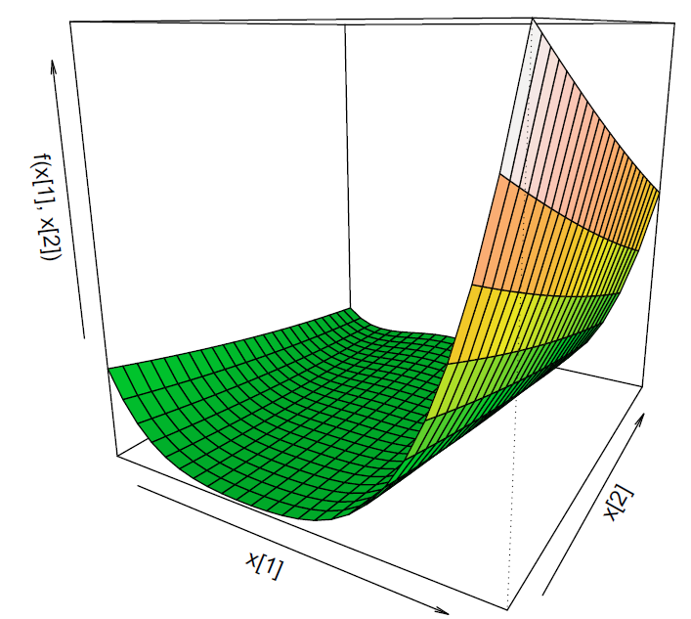
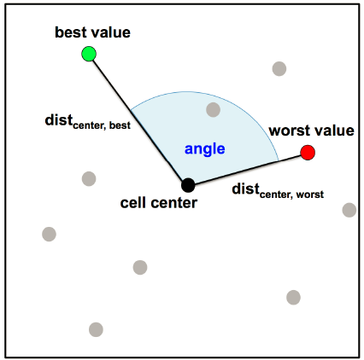
Cell Mapping Techniques (CM)
Broadening the ELA-Featureset
Cell mapping features give insight on global properties
Relatively cheap to compute
Kerschke, P., Preuss, M., Hernandez, C., Schütze, O., Sun, J.-Q., Grimme, C., Rudolph, G., Bischl, B., Trautmann, H.,
Cell Mapping Techniques for Exploratory Landscape Analysis in EVOLVE 2014, pp. 115-131.
Notes:
Cell mapping employs this discretization for dividing the state space into hypercubes.
Cells help to get insight in global landscape.

Slide 7

Flacco Dataset
Image: http://dailygenius.com/wp-content/uploads/2014/09/data.jpg

Slide 8
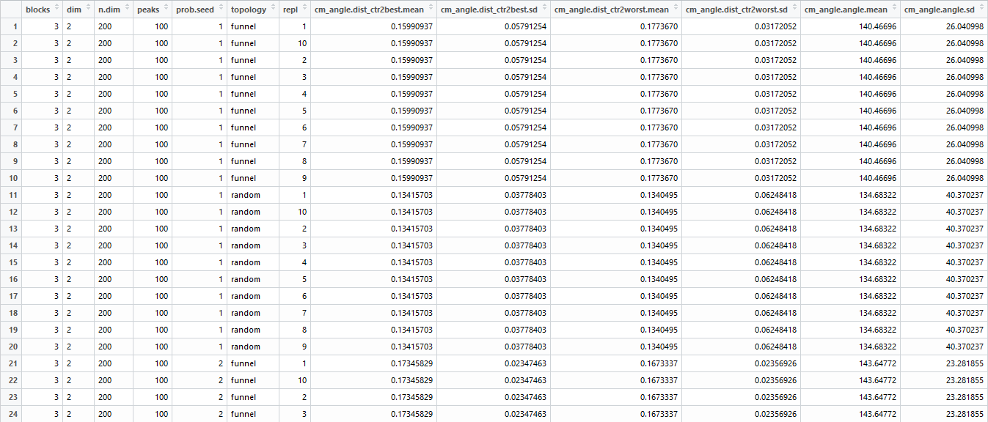
Flacco Dataset
First overview

Slide 9
Flacco Dataset
Structure
Dataset of 73 (65) columns and 3000 observations
Metadata
Cell Mapping Features
cm_angle (angle between best and worst point within cell)
cm_conv (convexity of neighbouring cells)
cm_grad (gradient homogenity)
ELA Features
ela_conv (convexity; randomly choosen observations)
ela_curv (curvature)
ela_local (certain num of local searches)

Slide 10
Flacco Dataset
Metadata Structure
Metadata describes how problem instance created in flacco random generator
Number of cells (blocks)
Number of peaks
Seed of the generator
Replication index
Landscape topology (random, funnel)

Slide 11
Outlier Detection

Slide 12
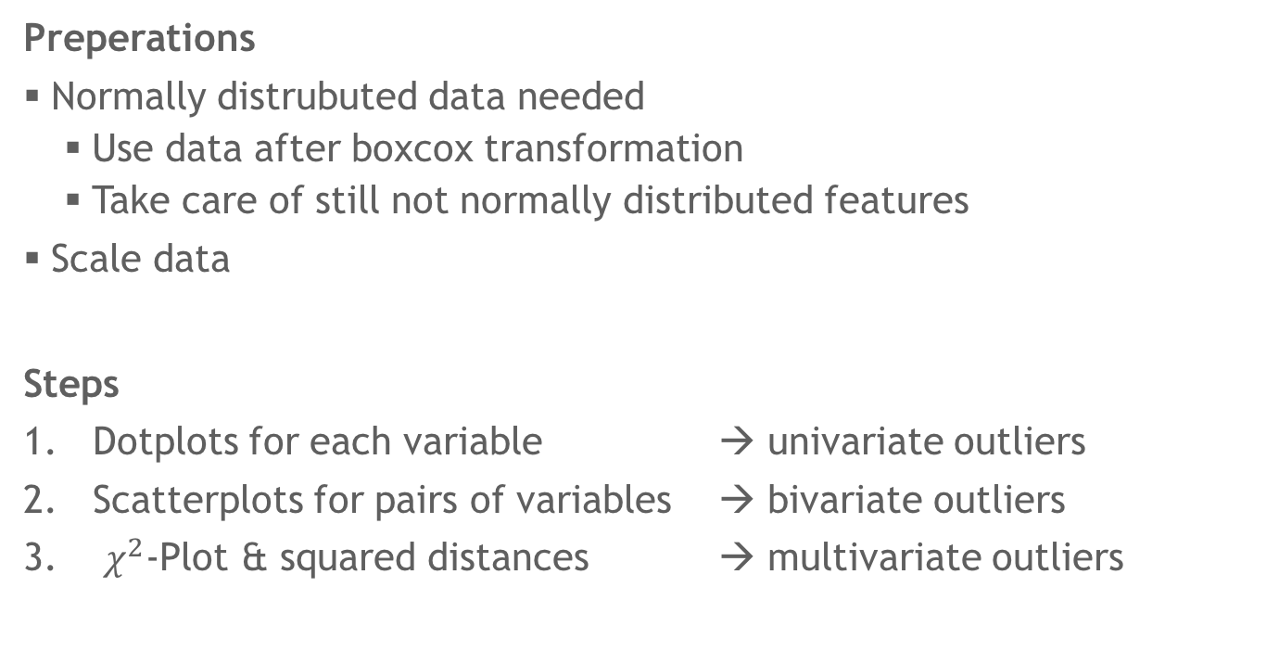
Outlier Detection
Overview
Preperations
Normallydistrubuteddataneeded
Usedata after boxcoxtransformation
Take care of still not normallydistributedfeatures
Scaledata
Steps
Dotplotsfor each variable →univariate outliers
Scatterplots forpairsof variables →bivariateoutliers
$χ^{2}$-Plot &squareddistances→ multivariate outliers

Slide 13
Outlier Detection
Univariate Outliers
Determine univariate outliers by dotplots
65 univariate outliers

Slide 14
Outlier Detection
Univariate Outliers
Have a look at Boxplots additionally
Feat 12 not normally distributed → ignore
Notes:
Determine max sigma value per row, exclude outliers with sigma > 4.5 (in contrast to 3.5 in lecture due to high number of rows)

Slide 15
Outlier Detection
Bivariate Outliers
Large number of dimensions
→ identify outliers within feature groups + between PCs of feature groups

Slide 16

Outlier Detection
Multivariate Outliers
Using$χ^{2}$-Plot todetermine multivariate outliers
(wholedataset& per featuresgroup)

Slide 17
Outlier Detection
Multivariate Outliers

Slide 18
Outlier Detection
Results
Univariate: 65
Bivariate:
Multivariate: 125
Total: 190
➔ 2810 observations left for further steps

Slide 19

Multi-Dimensional Scaling
Image: http://vignette1.wikia.nocookie.net/interstellarfilm/images/3/36/Nl8KjBO_-_Imgur.png/revision/latest?cb=20141115140115

Slide 20
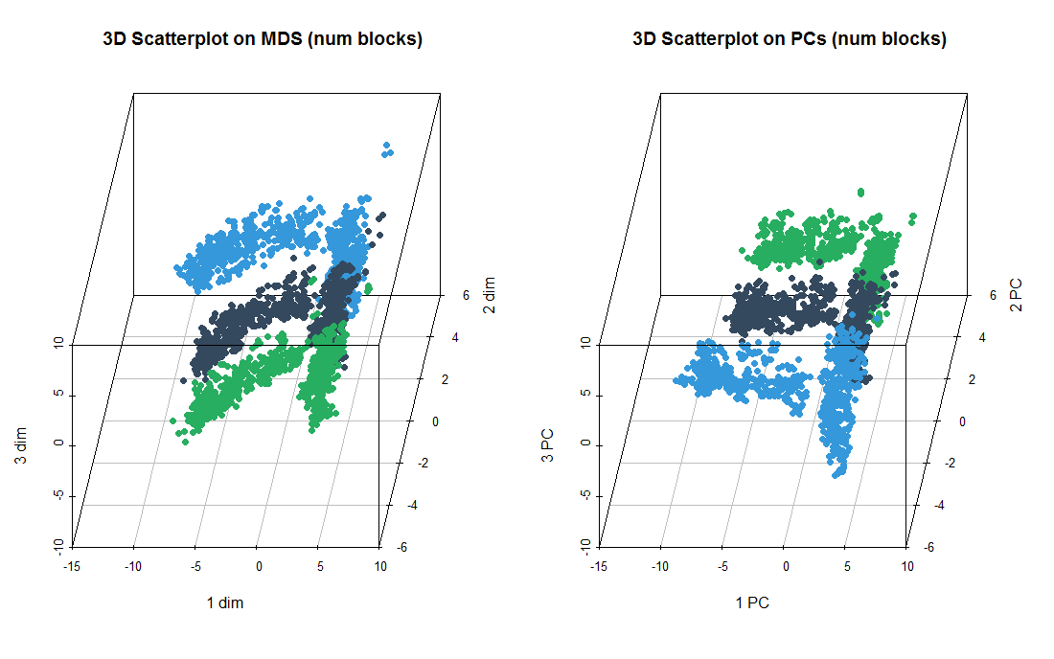

Multi-Dimensional Scaling
Comparison to PCA
MDS based on all features leads to same configuration as PCA (besides rotation) -> scale data in advance
Notes:
Mention: built-in vs methodology reveals same result

Slide 21
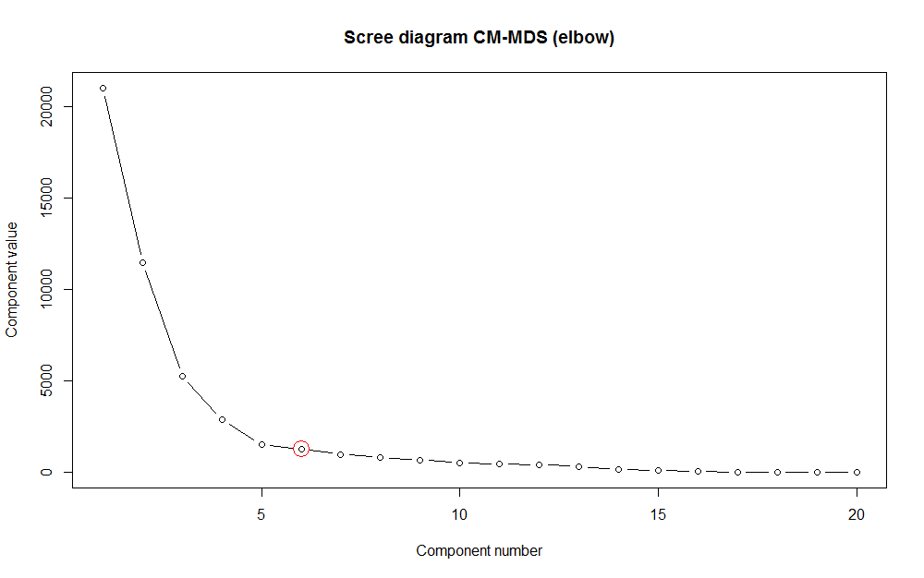
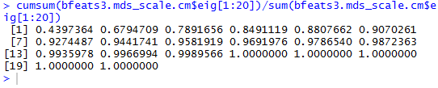
Multi-Dimensional Scaling
Visualizing CM-Features
Reducing data to lower dimensionality by using Cell Mapping-features
cm_angle, cm_conv, cm_grad
4 dimensions for explaining 80% of variance
Screeplot shows up elbow at 6th dimension

Slide 22
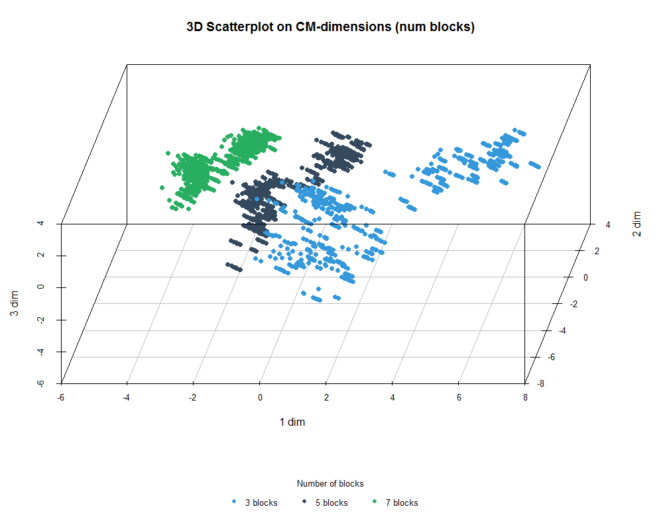
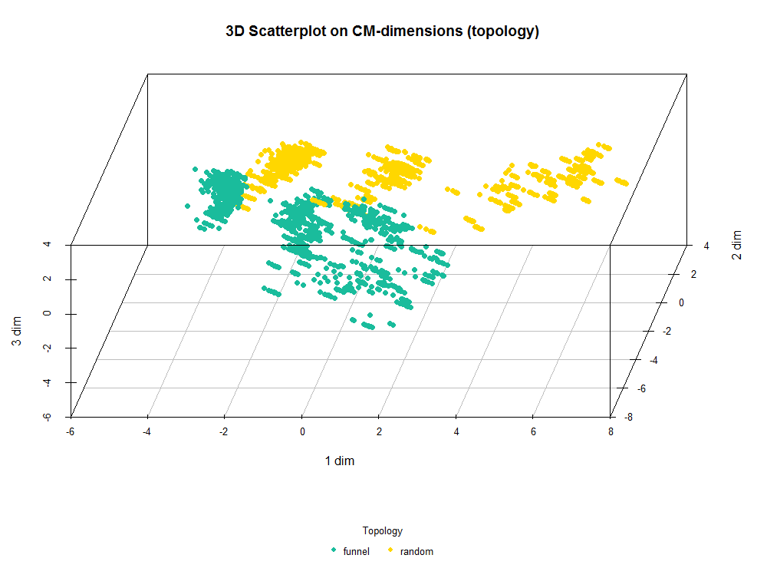
Multi-Dimensional Scaling
Visualization of MDS on CM-Features
Strong influence of blocks information and landscape topology can be seen in CM-Features
Notes:
Mention: built-in vs methodology reveals same result

Slide 23
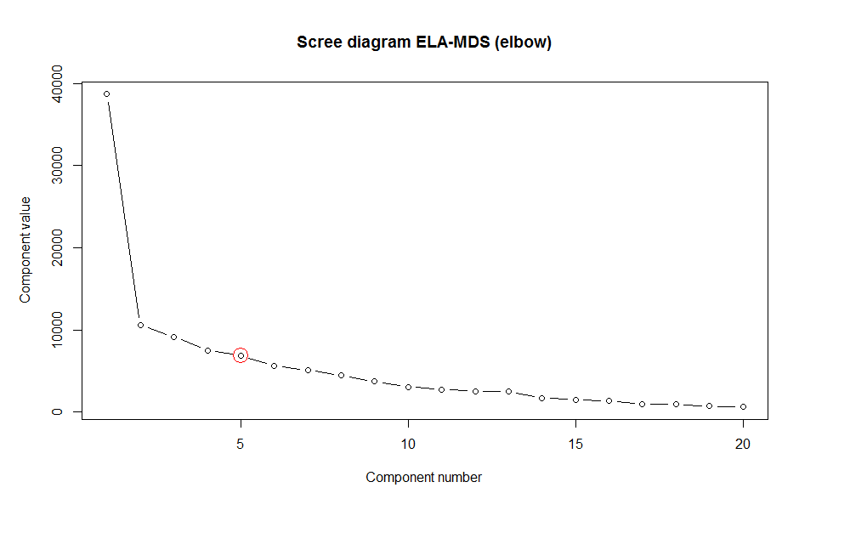
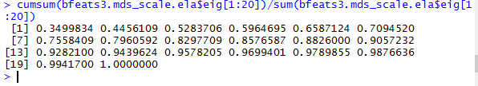
Multi-Dimensional Scaling
Visualizing ELA-Features
Reducing data to lower dimensionality by using ELA-featuregroups
ela_conv, ela_curv, ela_local
9 dimensions for explaining 80% of variance
Screeplot shows up elbow at 5th dimension

Slide 24
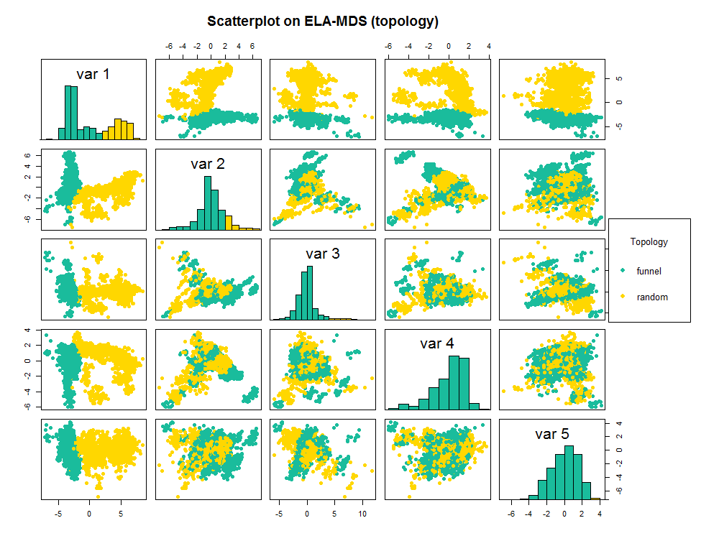
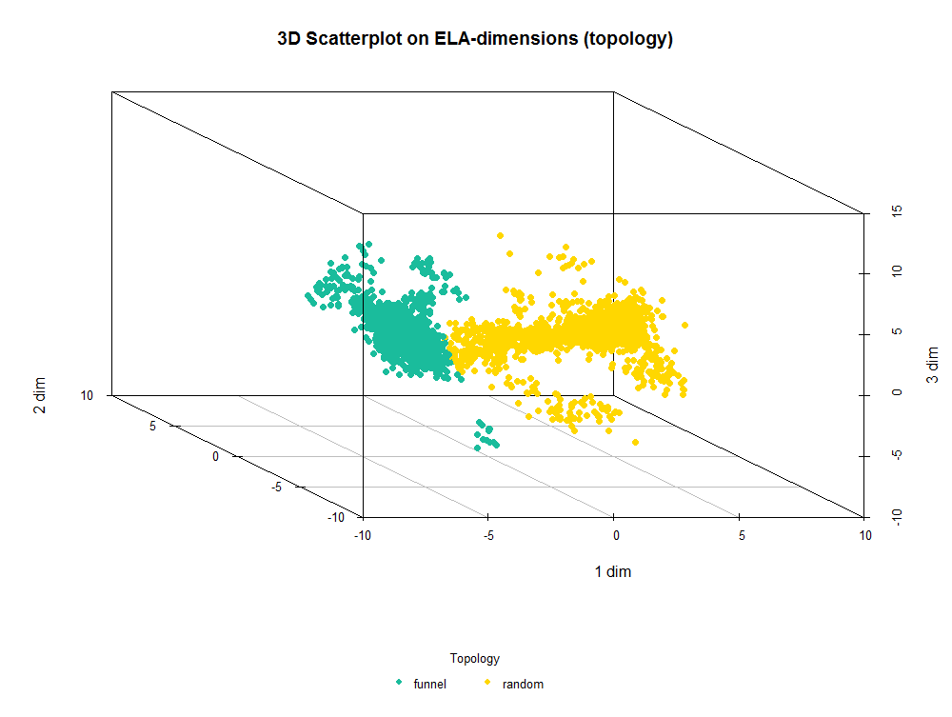
Multi-Dimensional Scaling
Visualization of MDS on ELA-Features
Strong influence of landscape topology can be seen in ELA-Features; no influence of blocks setting
Notes:
Mention: built-in vs methodology reveals same result

Slide 25
Thank you for your attention
Christian Siemen (394724)

